Slide 1

GRAPH THEORY AND ITS APPLICATIONS
Dr. Arti Arya
Department of Computer Science & Engineering

Slide 2

GRAPH THEORY, APPLICATIONS AND COMBINATORICS
Neo4j Graph Data Model
Dr. Arti Arya
Department of Computer Science & Engineering

Slide 3
Graph Theory and its Applications Acknowledgement
The slides are prepared by Dr. Surabhi Narayan and a lot of inputs are added by Dr. Arti Arya. The sources of the information other than textbook is mentioned wherever used.

Slide 4
Graph Theory, Applications and Combinatorics
Neo4j Graph Data Model
Graph data modeling is the process in which a user describes an arbitrary domain as a connected graph of nodes and relationships with properties and labels.
A Neo4j graph data model is designed to answer questions in the form of Cypher queries and solve business and technical problems by organizing a data structure for the graph database.
Graph Modeling Guidelines - Developer Guides (neo4j.com)

Slide 5
Graph Theory, Applications and Combinatorics
Graph Data Model= White board friendly
The graph data model is often referred to as being "whiteboard-friendly".
Typically, when designing a data model, people draw example data on the whiteboard and connect it to other data drawn to show how different items connect.
The whiteboard model is then re-formatted and structured to fit normalized tables for a relational model.
A similar process exists in graph data modeling, as well. However, instead of modifying the data model to fit a normalized table structure, the graph data model stays exactly as it was drawn on the whiteboard.
This is where the graph data model gets its name for being "whiteboard-friendly".
Graph Modeling Guidelines - Developer Guides (neo4j.com)

Slide 6
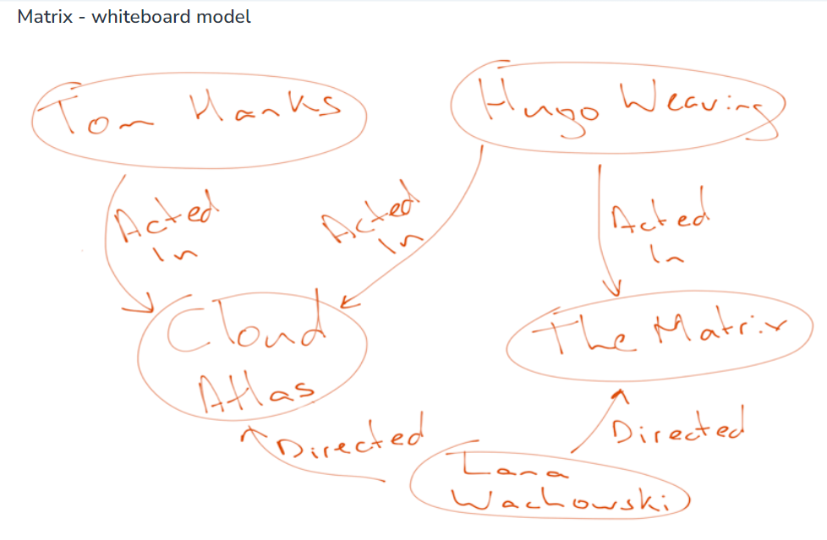
Graph Theory, Applications and Combinatorics
Graph Data Model= White board friendly
Let us look at an example to demonstrate this. In the whiteboard drawing below, we have a data set about the movie "The Matrix".
Graph Modeling Guidelines - Developer Guides (neo4j.com)

Slide 7
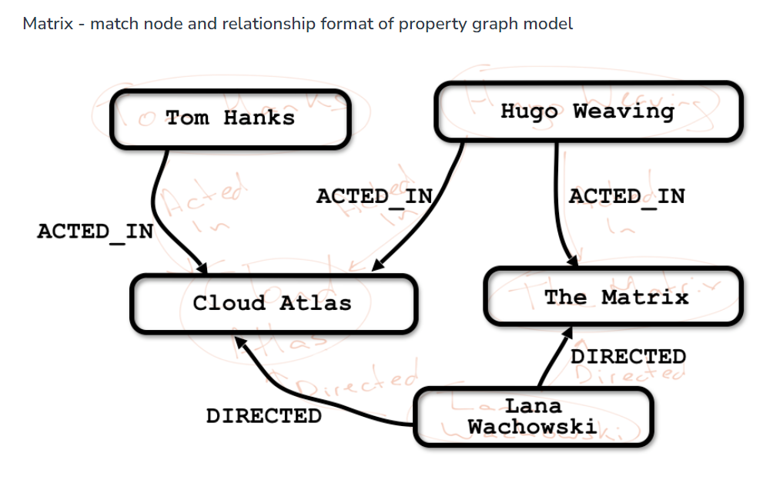
Graph Theory, Applications and Combinatorics
Graph Data Model= White board friendly
Let us look at an example to demonstrate this. In the whiteboard drawing below, we have a data set about the movie "The Matrix".
Next, we formalize our entities a bit and match expected syntax for relationship types to create the node/relationship view for the property graph model.
Graph Modeling Guidelines - Developer Guides (neo4j.com)

Slide 8
Graph Theory, Applications and Combinatorics
Neo4j Graph Data Model
Neo4j Property Graph Data Model
A labeled property graph is made up of nodes, relationships, properties, and labels.
Nodes contain properties. Think of nodes as documents that store properties in the form of arbitrary key-value pairs. In Neo4j, the keys are strings and the values are the Java string and primitive data types, plus arrays of these types.
Nodes can be tagged with one or more labels. Labels group nodes together, and indicate the roles they play within the dataset.

Slide 9
Graph Theory, Applications and Combinatorics
Neo4j Graph Data Model
Neo4j Property Graph Data Model
Relationships connect nodes and structure the graph. A relationship always has a direction, a single name, and a start node and an end node—there are no dangling relationships. Together, a relationship’s direction and name add semantic clarity to the structuring of nodes.
Like nodes, relationships can also have properties. The ability to add properties to relationships is particularly useful for providing additional metadata for graph algorithms, adding additional semantics to relationships (including quality and weight), and for constraining queries at runtime.

Slide 10
Graph Theory, Applications and Combinatorics
Neo4j Graph Data Model
In summary,
The model represents data in Nodes, Relationships and Properties
Properties are key-value pairs
Nodes are represented using circle and Relationships are represented using arrow keys
Relationships have directions: Unidirectional and Bidirectional
Each Relationship contains "Start Node" or "From Node" and "To Node" or "End Node"
Both Nodes and Relationships contain properties
Relationships connects nodes

Slide 11
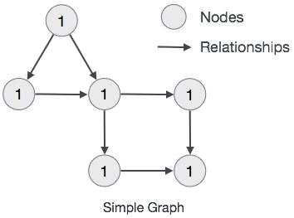
Graph Theory, Applications and Combinatorics
Neo4j Graph Data Model
The main building blocks of Graph DB Data Model are −
Nodes
Relationships
Properties

Slide 12
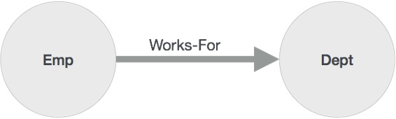
Graph Theory, Applications and Combinatorics
Neo4j Graph Data Model
Node is a fundamental unit of a Graph. It contains properties with key-value pairs as shown in the following image.
Property is a key-value pair to describe Graph Nodes and Relationships.
Relationships are another major building block of a Graph Database. It connects two nodes as depicted in the following figure.
Node
Relationship

Slide 13
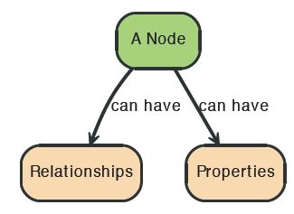

Graph Theory, Applications and Combinatorics
Neo4j Graph Data Model
Node

Slide 14
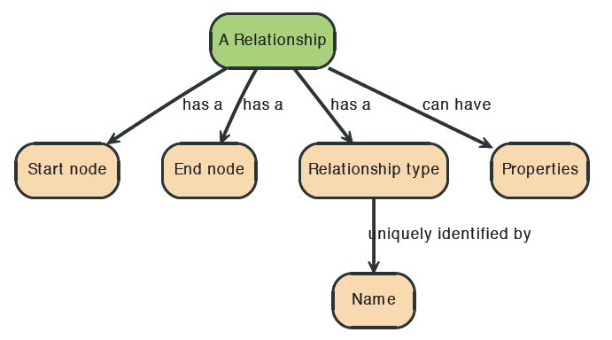
Graph Theory, Applications and Combinatorics
Neo4j Graph Data Model
Relationships

Slide 15



Graph Theory, Applications and Combinatorics
Neo4j Graph Data Model
Relationships

Slide 16
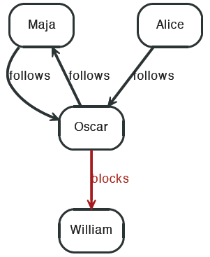


Graph Theory, Applications and Combinatorics
Neo4j Graph Data Model

Slide 17
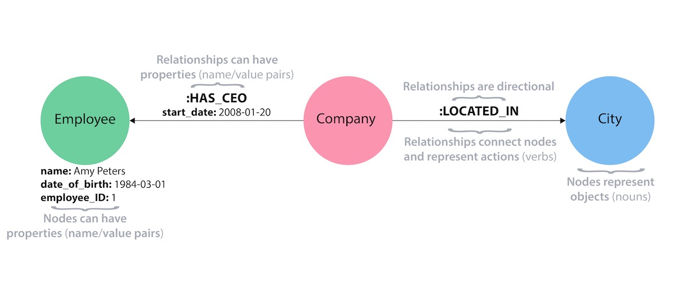
Graph Theory, Applications and Combinatorics
Neo4j Graph Data Model

Slide 18
Graph Theory, Applications and Combinatorics
Neo4j Graph Data Model
Properties
Both nodes and relationships can have properties.
Properties are key-value pairs where the key is a string.
Property values can be either a primitive or an
array of one primitive type.
For example String, int and int[] values are valid for properties.

Slide 19
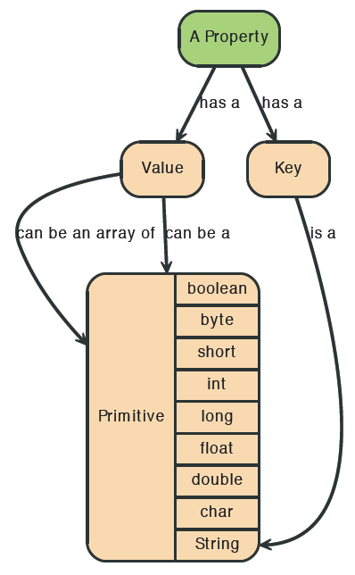
Graph Theory, Applications and Combinatorics
Neo4j Graph Data Model
Properties

Slide 20

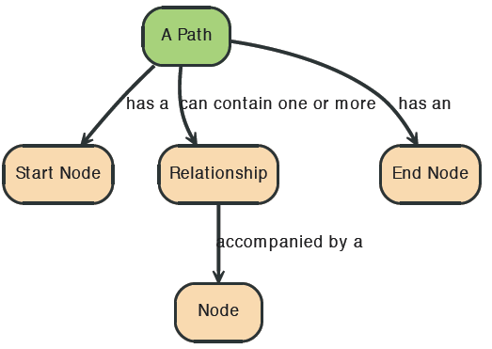
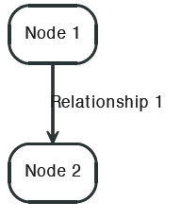
Graph Theory, Applications and Combinatorics
Neo4j Graph Data Model
Path
A path is one or more nodes with connecting relationships, typically retrieved as a query or traversal result.

Slide 21
THANK YOU
Dr. Arti Arya
Department of Computer Science &Engineering

